Slide 1


Promo Code Impact On Shopping Behavior
Presented By Group 6: Pengbo Gao (220307831), Yuhui Gu (220128716), Yaosheng Liu (216173163), Yisong Lu (216379927), Lingrui Yu (220771929),
Jingze Zhang (220240248), Tianchen Zhu (217755976)

Slide 2

Executive Summary
Objective of the Report
Methodology
Expected Outcome
Investigate the causal relationship between the use of promo codes and the purchase amount
Determine the effectiveness of promo codes in potentially increasing the average order value
Application of descriptive statistics and predictive modelling to analyze data
Executive Summary
Problem Statement
Descriptive Analysis
Causality Analysis
Business Insights
Implementation Issues

Slide 3


Reassessing Promo Code Strategy: Analytics and Business Problems ​
Methodology​
Propensity score matching, OLS regression, and IV analysis were used to determine the causal effect of promotional codes on purchase behavior.
Analytics Problem​
Statistical analysis was used to investigate the effect of promo codes on average customer spending.
Business Problem​
A shift in promotional strategy from a sales focus to an emphasis on increasing customer engagement, loyalty and long-term relationships through promotional codes is needed.
Findings
The analysis revealed no significant increase in spending due to promo codes, indicating their influence may not directly boost sales revenue as anticipated. ​
Executive Summary
Problem Statement
Descriptive Analysis
Causality Analysis
Business Insights
Implementation Issues

Slide 4


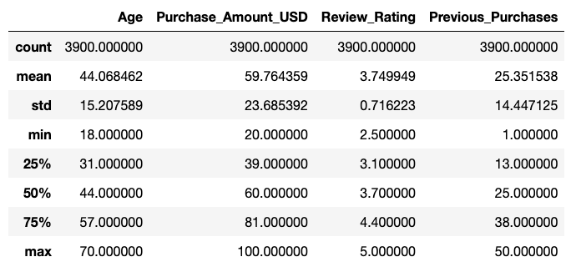


Descriptive Analysis
Previous Purchases
Age Demographics
Average previous purchases: 25
Purchase range: 1 to 50
The median of 25 indicates a mix of new and frequent customers
Age range: 18 to 70
Average age: 44
The majority are middle-aged with 50% between 31 and 57
Purchase Amount (USD)
Review Rating
Average purchase: $59.76
Purchase range: $20 to $100
Middle 50% of purchases: $39 to $81
Average rating: 3.75 out of 5
Rating range: 2.5 to 5
Median rating close to mean indicates even distribution
Executive Summary
Problem Statement
Descriptive Analysis
Causality Analysis
Business Insights
Implementation Issues

Slide 5
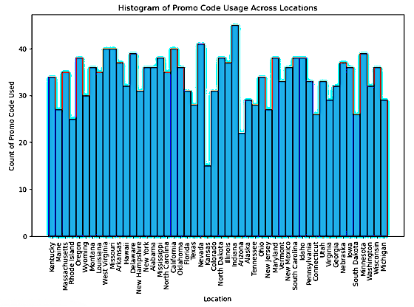
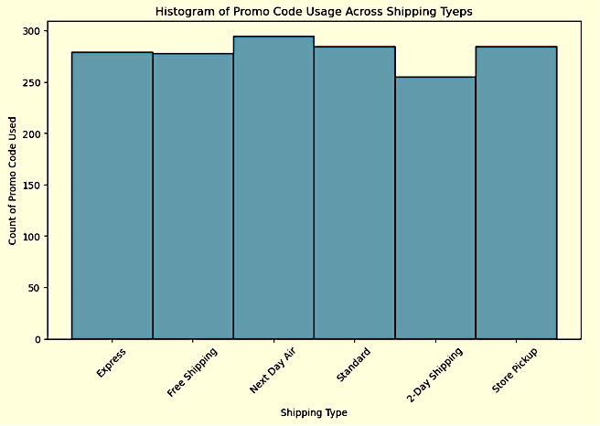
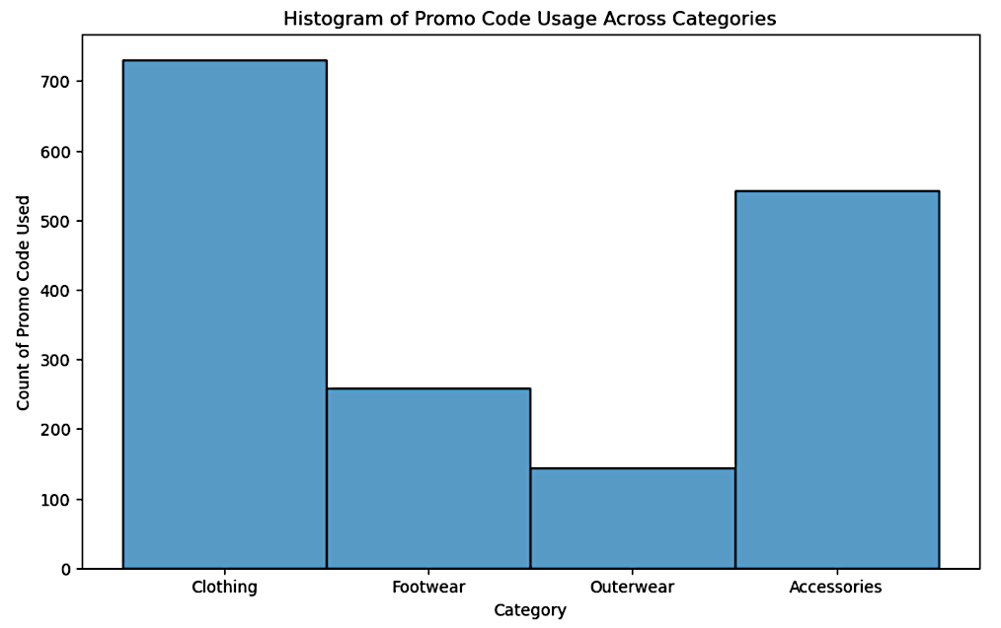
Descriptive Analysis
Distribution Across Locations
Shipping Types
Different Categories
Uniform distribution of promo code usage across shipping types
Indicates shipping choice does not significantly impact promo code usage
Geographic variation in promo code usage
The highest count in Indiana, lowest in Kansas
Highest promo code usage for clothing, lowest for accessories
Prioritize the use of promo codes on higher value or frequently purchased items
Executive Summary
Problem Statement
Descriptive Analysis
Causality Analysis
Business Insights
Implementation Issues

Slide 6
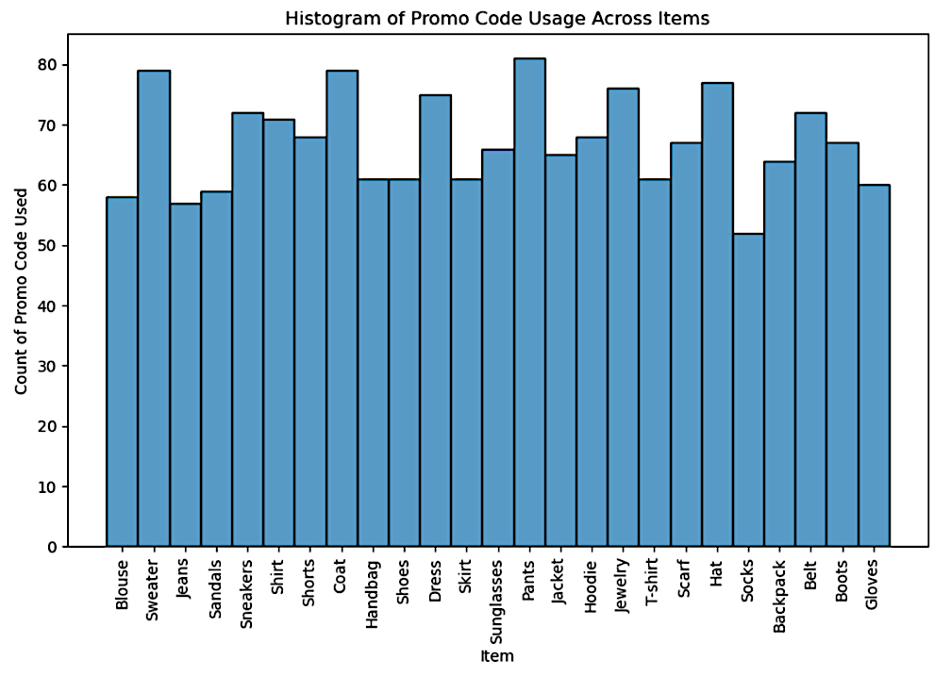
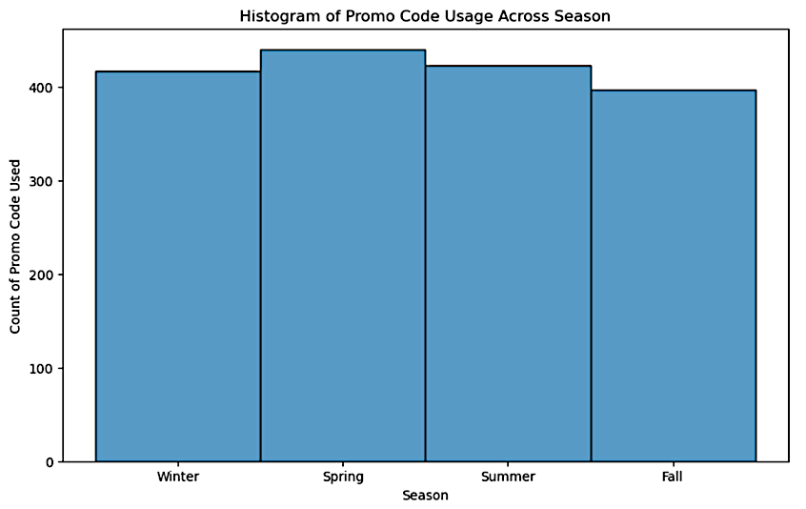
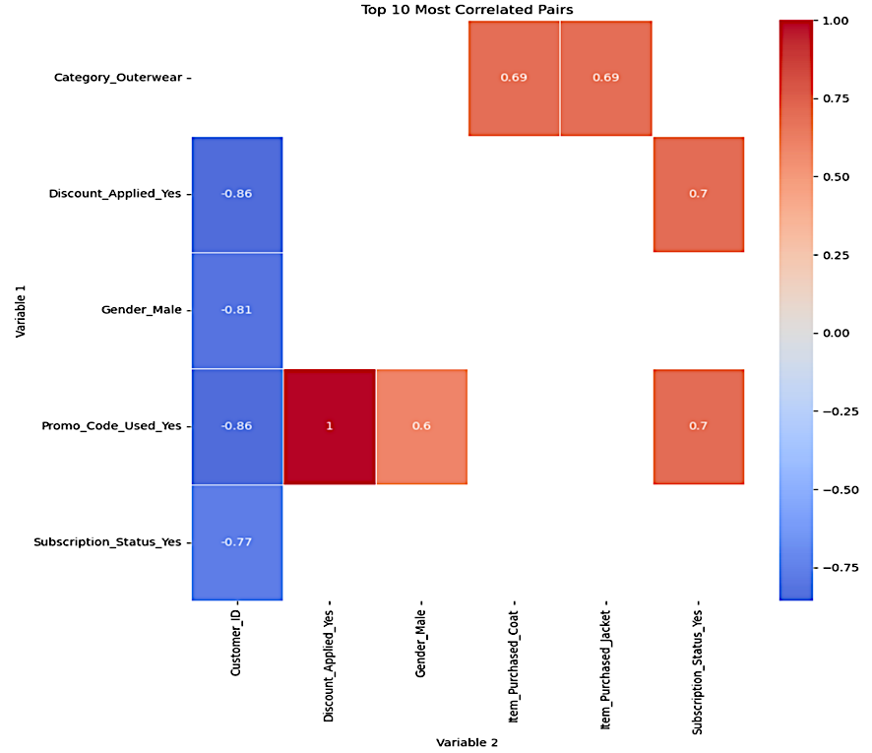
Descriptive Analysis
Different Purchase Item
Seasonal Trends
Top 10 Most Correlated Variable Pairs
Highest for pants, lowest for socks
No single item category dominates in promo code usage
Red indicates positive correlation strength, while blue is negative.
Notable correlation between applied discount and used promo code.
Consistent promo code usage throughout the year
Slight variations observed between seasons
Executive Summary
Problem Statement
Descriptive Analysis
Causality Analysis
Business Insights
Implementation Issues

Slide 7
Descriptive Analysis
Introduction of
Segmentation & Control Analysis
Rationale for 'Gender’ & 'Location'
01
02
Shopping habit varies significantly from gender and geographical differences can reveal regional trends in spending
It provides foundational knowledge for informed causal analysis by uncovering patterns and behaviors across different customer groups
Bias Mitigation
Enhancing Causal Inference
Analyzing diverse customer segments reduces potential selection biases in the causal model, ensuring comparability between treatment and control groups
Segmentation analysis helps identify relevant covariates for causality analysis, ensures balanced analysis across segments, and improves the accuracy of causality inferences by controlling for confounding variables
04
03
Executive Summary
Problem Statement
Descriptive Analysis
Causality Analysis
Business Insights
Implementation Issues

Slide 8
Methodology Overview
Analysis of mean spending per transaction within each gender and location segment
Average Purchase Amount (USD)
Examination of the proportion of transactions using promo codes in each segment
Promo Code Usage
Assessment of average customer satisfaction rating for purchases in each segment
Review Ratings
Evaluation of the mean number of prior purchases for customers in each segment
Previous Purchases
Executive Summary
Problem Statement
Descriptive Analysis
Causality Analysis
Business Insights
Implementation Issues

Slide 9




Descriptive Analysis: Analysis Overview
Purchase Amount by Segment
Promo Code Usage Patterns
Customer Satisfaction
Customer Loyalty Indicators
Analysis shows variations in average spending across different gender-location segments, highlighting diverse purchasing behaviors
Observed diverse promo code usage rates among segments, suggesting variations in price sensitivity and responsiveness to marketing
Review ratings across segments are generally positive, indicating a consistent level of satisfaction with products or services
Variations in the frequency of previous purchases by segment, point to different levels of customer loyalty and engagement
Executive Summary
Problem Statement
Descriptive Analysis
Causality Analysis
Business Insights
Implementation Issues

Slide 10

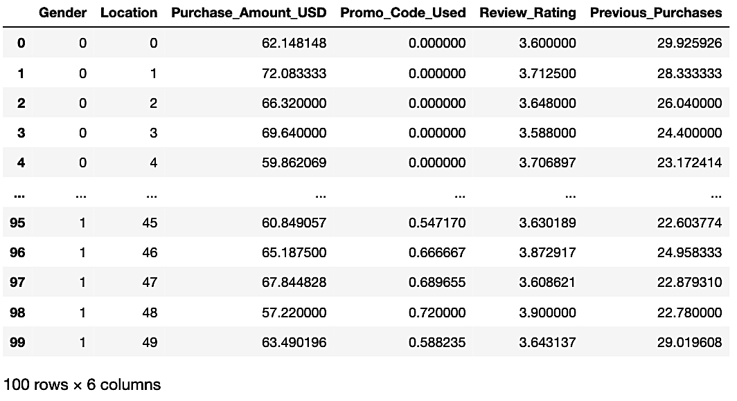

Descriptive Analysis
Results
Key Findings
Distinct spending patterns across gender-location segments, varied promo code usage, and high customer satisfaction levels.
These insights suggest opportunities for targeted marketing and deeper exploration of customer loyalty and spending behaviors.
Limitation
Conclusion & Business Insight
It doesn't conclusively establish a cause-and-effect link between promo code use and purchasing behavior, indicating a need for further research.
The analysis offers key insights into customer segments' interactions with promo codes, spending, satisfaction, and loyalty, essential for shaping targeted marketing and understanding promo codes' impact on purchases.
Executive Summary
Problem Statement
Descriptive Analysis
Causality Analysis
Business Insights
Implementation Issues

Slide 11
Causality Analysis: Propensity Score Matching
Methodology
Findings
A PSM analysis balanced the comparison between customers using a promo code (treatment group) and those who didn't (control group).
Calculated using logistic regression, considering covariates such as ‘Age’, ‘Review_Rating’, ‘Previous_Purchases’, and ‘Category’.
The Standardized Mean Differences for all covariates post-matching were close to zero.
The Average Treatment effect on the Treated (ATT) was found to be -1.1491.
The p-value for ‘Promo_Code_Used’ was determined to be 0.164.
Executive Summary
Problem Statement
Descriptive Analysis
Causality Analysis
Business Insights
Implementation Issues

Slide 12
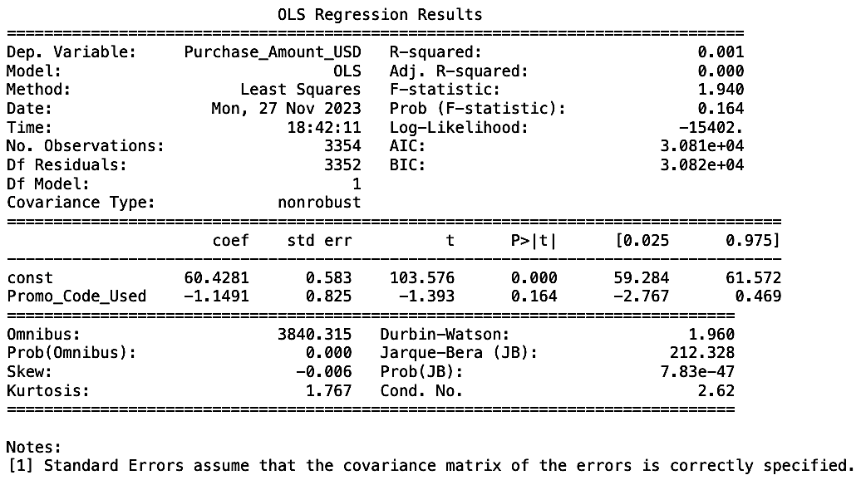
Causality Analysis: Propensity Score Matching
Results
Model Efficiency
The R-squared value is 0.001.
The mode explains only 0.1% of the variance in purchase amounts, signifying a very low explanatory power.
Limitation
Other factors not included in the model may influence purchase amounts.
Conclusion & Business Insight
No statistically significant evidence to support the idea that promo code usage affects purchase amounts in USD.
Consider other potential benefits of promo codes, such as customer acquisition, retention, and increased transaction frequency, which may contribute to long-term business value.
Executive Summary
Problem Statement
Descriptive Analysis
Causality Analysis
Business Insights
Implementation Issues

Slide 13
Causality Analysis: Instrumental Variable Analysis
Methodology
An IV analysis using 'Location' as an initial instrument revealed it to be weak after checking its F-statistic.
'Gender' was then chosen for its strong correlation with promo code usage, reflecting literature on gender-specific shopping behaviors.
Findings
Instrumental variable ‘Location’:
The low F-statistic of 0.55 indicates that ‘Location’ is a weak instrument, poorly correlated with ‘Promo_Code_Used’.
Instrumental Variable ‘Gender’:
First Stage F-Statistic: High at 2145, showing 'Gender' strongly predicts 'Promo_Code_Used’.
Second Stage F-Statistic: At 6.4459, it's under 10, indicating a weak model for 'Purchase_Amount_USD’ variations.
Executive Summary
Problem Statement
Descriptive Analysis
Causality Analysis
Business Insights
Implementation Issues

Slide 14
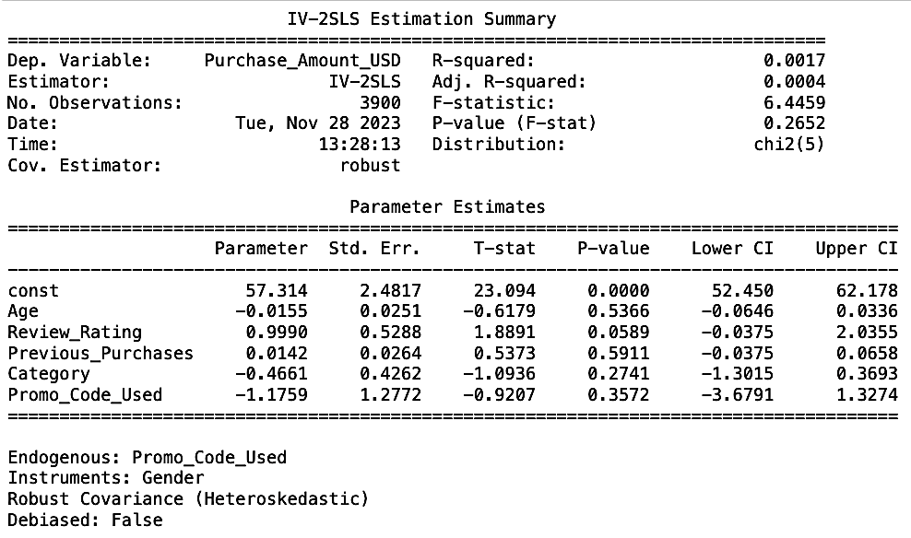
Causality Analysis: Instrumental Variable Analysis
Impact on Purchase Amount
Coefficient: The coefficient for ‘Promo_Code_Used’ is -1.1759, suggesting an average decrease in. Purchase amount by $1.18 when a promo code is used.
Statistical significance: With a p-value of 0.3572 for ‘Promo_Code_Used’, the results are not statistically significant, failing to provide string evidence against the null hypothesis.
Conclusion & Business Insight
The IV analysis shows no significant impact of promo codes on purchase amounts. 'Location' and 'Gender' had varying first-stage strengths, but neither showed a significant effect on purchases.
The selected instruments failed to significantly link promo code usage and purchase amounts.
The models' low explanatory power hints at other influential variables not included in this analysis.
Executive Summary
Problem Statement
Descriptive Analysis
Causality Analysis
Business Insights
Implementation Issues

Slide 15
Business Insights & Implementations
Promo Code Strategy
Targeted Marketing
Customer Loyalty Programs
Promo codes, shown to not significantly increase purchase amounts, might be better suited for customer acquisition, retention, and engagement instead of boosting immediate spending.
Segmentation analysis insights enable businesses to create tailored marketing strategies, customizing promotions and communication for various customer preferences and behaviors.
The variability in previous purchase patterns across segments suggests an opportunity for customized loyalty programs, targeting segments with higher loyalty potential.
Executive Summary
Problem Statement
Descriptive Analysis
Causality Analysis
Business Insights
Implementation Issues

Slide 16
Potential Implementation Issues
Data Limitation
Change Management
The analyses' limitations stem from data constraints; including variables like income and product preferences could yield deeper insights in further research.
01
Refocusing promo codes from sales boosts to customer engagement requires effective internal communication and change management.
02
04
Causality Challenges
03
Operational Integration
The methods used, especially PSM and IV, have limitations in confirming causality, thus caution is needed in interpreting these results as definitive causal links.
Incorporating these analysis insights may necessitate substantial changes in marketing strategies and customer relationship management systems.
Executive Summary
Problem Statement
Descriptive Analysis
Causality Analysis
Business Insights
Implementation Issues

Slide 17
Thank You

